Slide 1
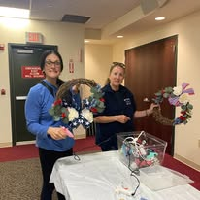
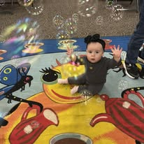

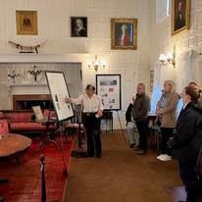
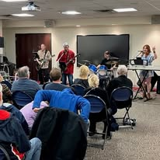
2026-27 Budget Information Meeting
March 31, 2026 @ 6:30 pm

Slide 2
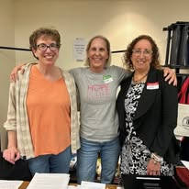
2026-27 Budget Review
Annual Statistics
Visitation up 41% from 55,799 to 78,640
Programs & Attendance 2% up & 10% down (670 to 683 & 17,842 to 16,160)
Reference Transactions down 3% from 15,986 to 15,456
Total Circulation up 13% from 99,596 to 112,807
Computer Usage up 46% from 3,732 to 5,437
Website Visits up 1% from 41,311 to 41,690
Wireless Sessions up 14% from 4,300 to 4,922
Database Retrieval up 215% from 6,752 to 21,260
Our mission is to provide quality service to all the residents of the Babylon School District in an open and non-judgmental environment with access to all library materials and services in a variety of formats.

Slide 3
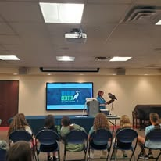
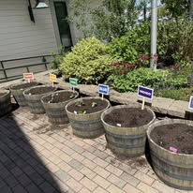
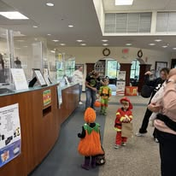
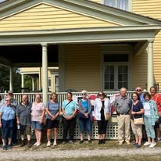
2026-27 Budget Review
Our community outreach once again, was significant this past year.
We were at the St. Patrick’s Day Parade, Spring Fling, Pride Parade, Fall Festival, 3 Chamber of Commerce Block Parties, Rotary Events, School Events, Village Events and shared events with other libraries in our Zone. We engaged with over 48,000 individuals at these events, an increase of 50% over last year’s 32,000.
We had 2 movie nights, plus our Happy Birthday Harry Potter Events at the Village Gazebo with about 300 in attendance for all three events.
Summer Reading Program statistics were mixed. 2024 we had a total of 509 registrants, and 2025 we had 421 total registrants, so a 21% decrease. However, our program attendance went from 4,963 in 2024 to 5,763 in 2025, a 16% increase.

Slide 4
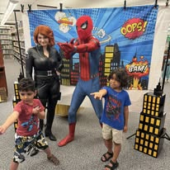
2026-27 Budget Review
Programs & Special Events
Our most popular programs this year were culinary programs, craft programs, socialization programs, and special events, and our new travel club events.
Our teens (The Preppy Loraxes) came in twelfth place at Suffolk County Battle of the Books.
Our Seed Library, Library of Things, and Museum Pass Program grew this past year, as we saw over 22,000 circulations of these items.
Museum Passes were checked out 413 times in 2025.
The Library of Things had over 150 check outs.
Video Games circulated over 240 times.

Slide 5
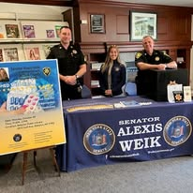
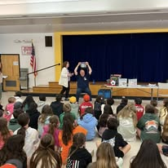
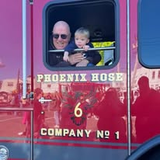
2026-27 Budget Review
Collaborations
This year we continued to partner with Babylon Village, Babylon Schools, and Babylon Village Arts Council. We also collaborated with the Babylon Village Chamber of Commerce, Babylon Rotary, Babylon Breast Cancer Coalition, Long Island Cares, Babylon Lions Club, Assemblyman Durso’s Office, Senators Martinez & Weik’s Offices, Babylon Village Historical Society, Town of Babylon Recreation Department, Councilman Manetta’s Office, Risewell, Stony Brook University, UB, SCLS, and many other organizations to assist the community of Babylon Village, and at large.

Slide 6

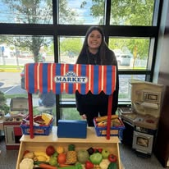
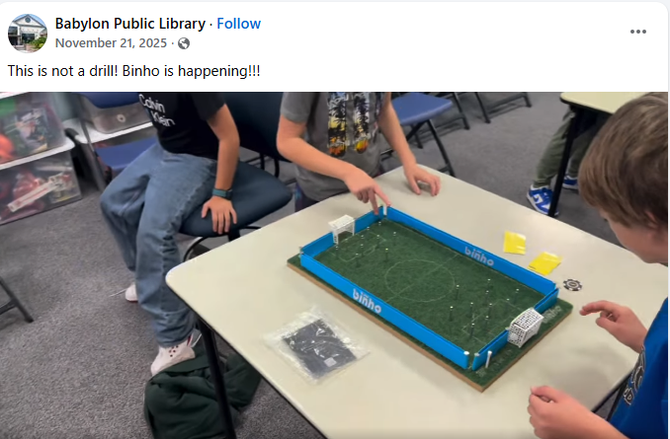

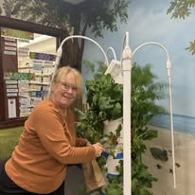

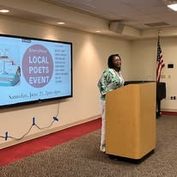
2026-27 Budget Review
New Additions

Slide 7

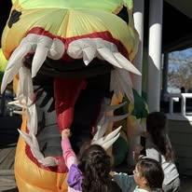
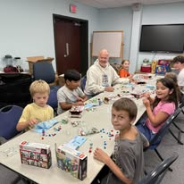
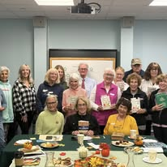

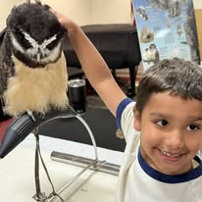
2026-27 Budget Review
Just for Fun!

Slide 8
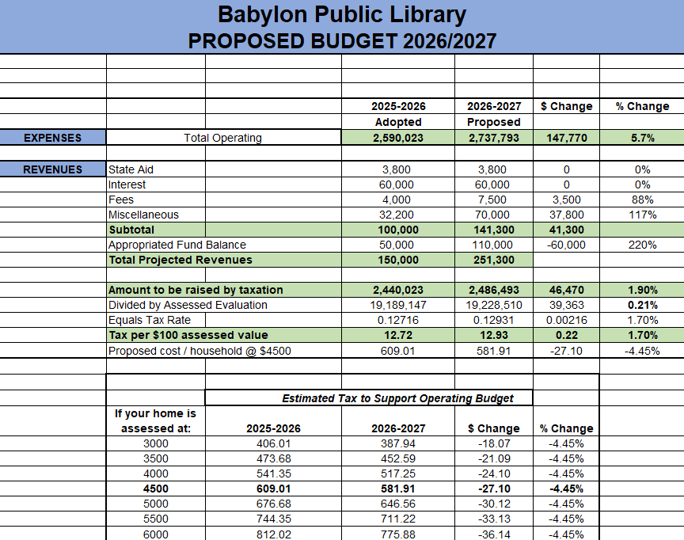
2026-27 Budget Review

Slide 9
2026-27 Budget Review
Goals & Objectives
Increase programming and collection through community involved strategic planning.
HVAC replacement, gutter replacement, technology upgrades, and the continued exploration of new planning of existing spaces to meet community demand.
Continue to work with our community partners to shape the future of our community.

Slide 10
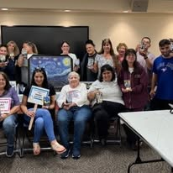
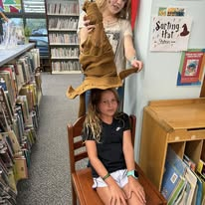
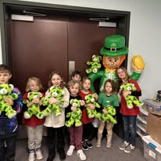
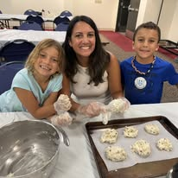
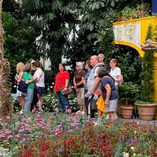
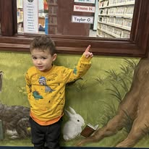
2026-27 Budget Review
PLEASE VOTE
Tuesday, April 14, 2026
12 Noon to 8 p.m.
Babylon Public Library
Community Room

